Slide 1
COMPUTER NETWORKS
Presentation Material
Department of Computer Science & Engineering
Course Code:19CS3602 |  | Semester: | VI
Course Title: COMPUTER NETWORKS |  | Year:2022
Faculty Name:

Slide 2
MODULE 2
Syllabus
Multi Access Protocols - ALOHA, CSMA, Collision free protocols, Ethernet- Physical
Layer, Ethernet Mac Sub layer, data link layer switching & use of bridges, learning bridges, spanning tree bridges, repeaters, hubs, bridges, switches, routers and gateways. LLC, WiFi,
Bluetooth Protocols.

Slide 3
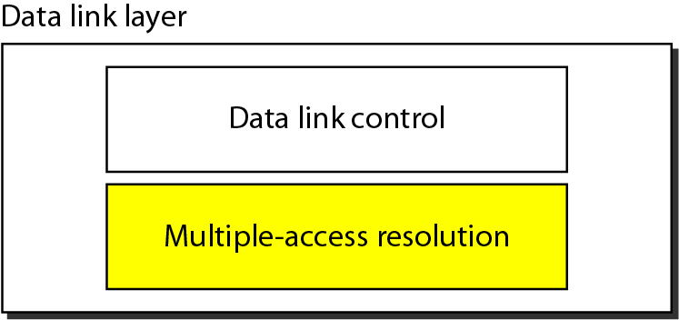
Figure 12.1 Data link layer divided into two functionality-oriented sublayers

Slide 4
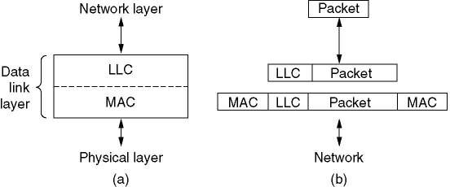
The protocols used to determine who goes next on a multi-access channel belong to a sublayer of the data link layer called the MAC (Medium Access Control) sublayer.
Technically, the MAC sublayer is the bottom part of the data link layer.

Slide 5
Networks can be divided into two categories:
1) Those using point-to-point connections and
2) Those using broadcast channels.
This chapter deals with broadcast networks and their protocols.

Slide 6
In any broadcast network, the key issue is how to determine who gets to use the channel when there is competition for it.
To make this point clearer, consider a conference call in which six peaple, on six different telephones, are all connected together so that each one can hear and talk to all the others.

Slide 7
It is very likely that when one of them stops speaking, two or more will start talking at once, leading to chaos.
In a face-to-face meeting, chaos is avoided by external means, for example, at a meeting, people raise their hands to request permission to speak.

Slide 8
When only a single channel is available, determining who should go next is much harder.
Many protocols for solving the problem are known and form the contents of this chapter.
In the literature, broadcast channels are sometimes referred to as multi-access channels or random access channels

Slide 9
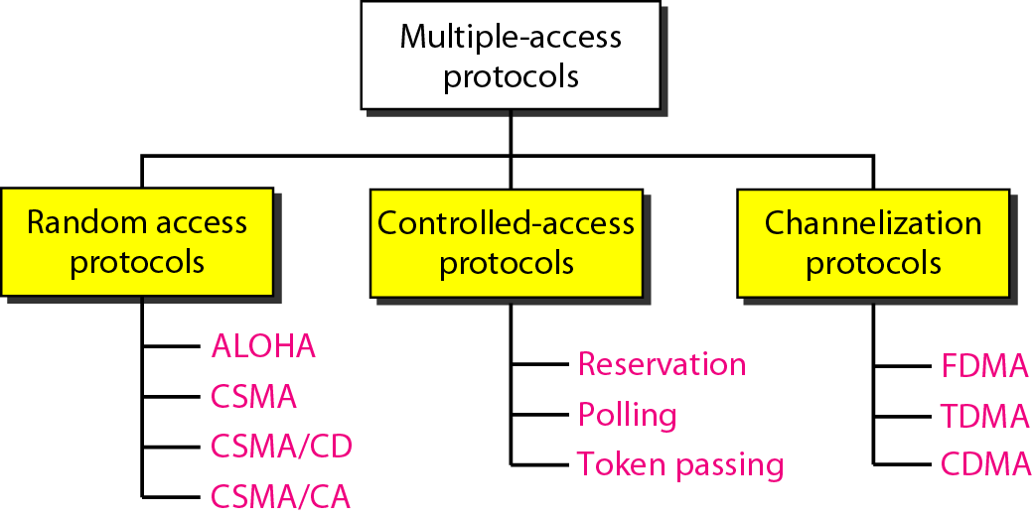
Figure 12.2 Taxonomy of multiple-access protocols discussed in this chapter

Slide 10
The MAC sublayer is especially important in LANs, nearly all of which use a multi- access channel as the basis of their communication.
WANs, in contrast, use point-to-point links, except for satellite networks.
Because multi-access channels and LANs are so closely related, in this chapter we will discuss LANs in general, as well as satellite and some other broadcast networks

Slide 11
4.2. Multiple Access Protocols
Many Algorithms for Allocating a Multiple Access Channel are Known.

Slide 12
12-1 RANDOM ACCESS
In random access or contention methods, no station is superior to another station and none is assigned the control over another. No station permits, or does not permit, another station to send. At each instance, a station that has data to send uses a procedure defined by the protocol to make a decision on whether or not to send.
Topics discussed in this section:
ALOHA Carrier Sense Multiple Access
Carrier Sense Multiple Access with Collision Detection
Carrier Sense Multiple Access with Collision Avoidance

Slide 13
In the following sections we will study a small sample of the mare interesting ones and give some examples of their use.
ALOHA
Carrier Sense Multiple Access Protocols
Collision-Free Protocols

Slide 14
ALOHA
Although Abramson’s work, called ALOHA system, used ground-based radio broadcasting, the basic idea is applicable to any system in which uncoordinated users are competing for the use of a single shared channel.
We will discuss two versions of ALOHA here: pure (1970) and slotted (1972). They differ with respect to whether time is divided into discrete slots into which all frames must fit. Pure ALOHA does not require global time synchronization; slotted ALOHA does.
27

Slide 15
Pure ALOHA (1)
The basic idea of an ALOHA system is simple: let users transmit whenever they have data to be sent.
There will be collisions, of course, and the colliding frames will be damaged.
However, due to the feedback property of broadcasting, a sender can always find out whether its frame was destroyed by listening to the channel, the same way other users do.

Slide 16
Pure ALOHA (2)
If listening while transmitting is not possible for some reason, acknowledgements are needed.
If the frame was destroyed, the sender just waits a random amount of time and sends it again.
Systems in which multiple users share a common channel in a way that can lead to conflicts are widely known as contention systems.

Slide 17
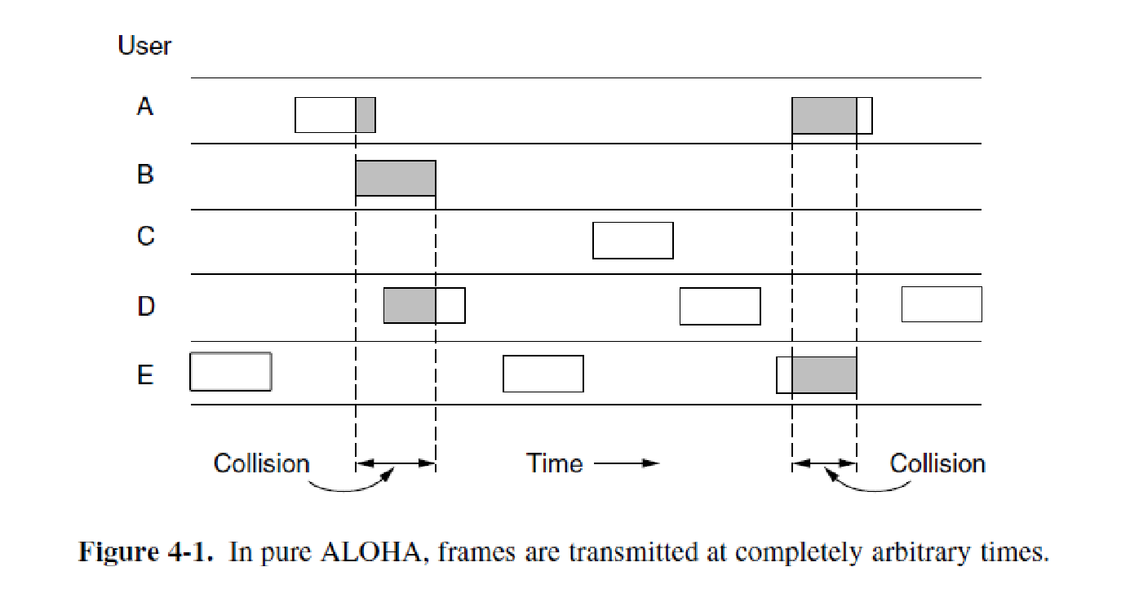
Pure ALOHA (3)
In pure ALOHA, frames are transmitted at completely arbitrary times.

Slide 18
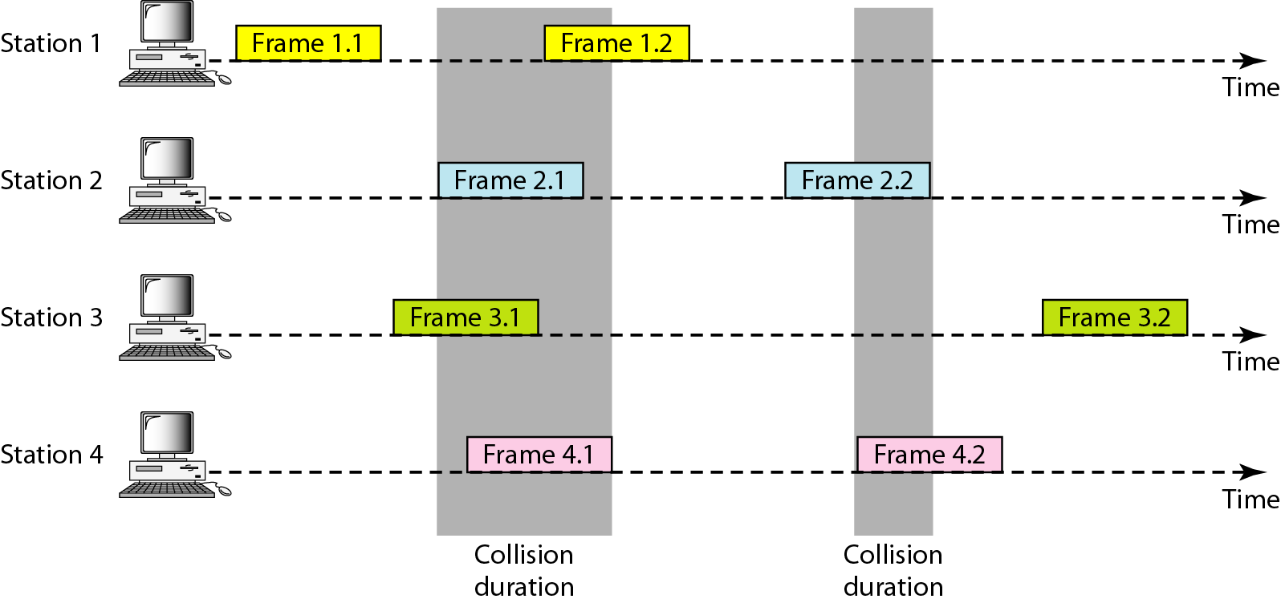
Figure 12.3 Frames in a pure ALOHA network

Slide 19
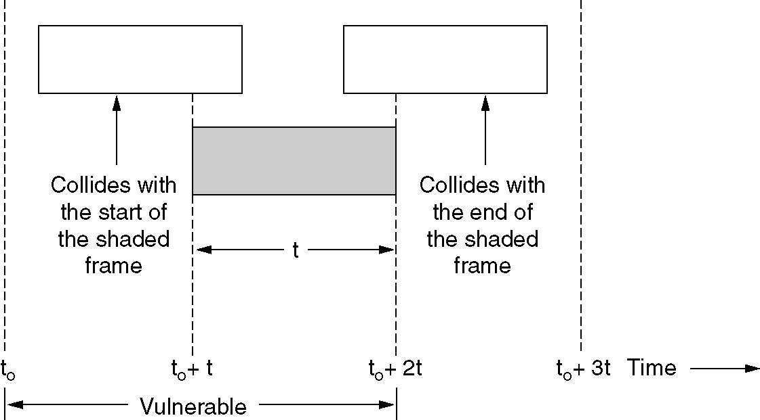
Pure ALOHA (4)
Vulnerable period for the shaded frame.

Slide 20
Slotted ALOHA (1)
In 1972, Roberts published a method for doubling the capacity of an ALOHA system. His proposal was to divide time into discrete intervals, each interval corresponding to one frame.
This approach requires the users to agree on slot boundaries. One way to achieve synchronization would be to have one special station emit a pip at the start of each interval, like a clock.

Slide 21
Slotted ALOHA (2)
In Roberts’ method, which has come to be known as slotted ALOHA, in contrast to Abramson’s pure ALOHA, a computer is not permitted to send whenever a carriage return is typed. Instead, it is required to wait for the beginning of the next slot
Thus, the continuous pure ALOHA is turned into a discrete one.

Slide 22
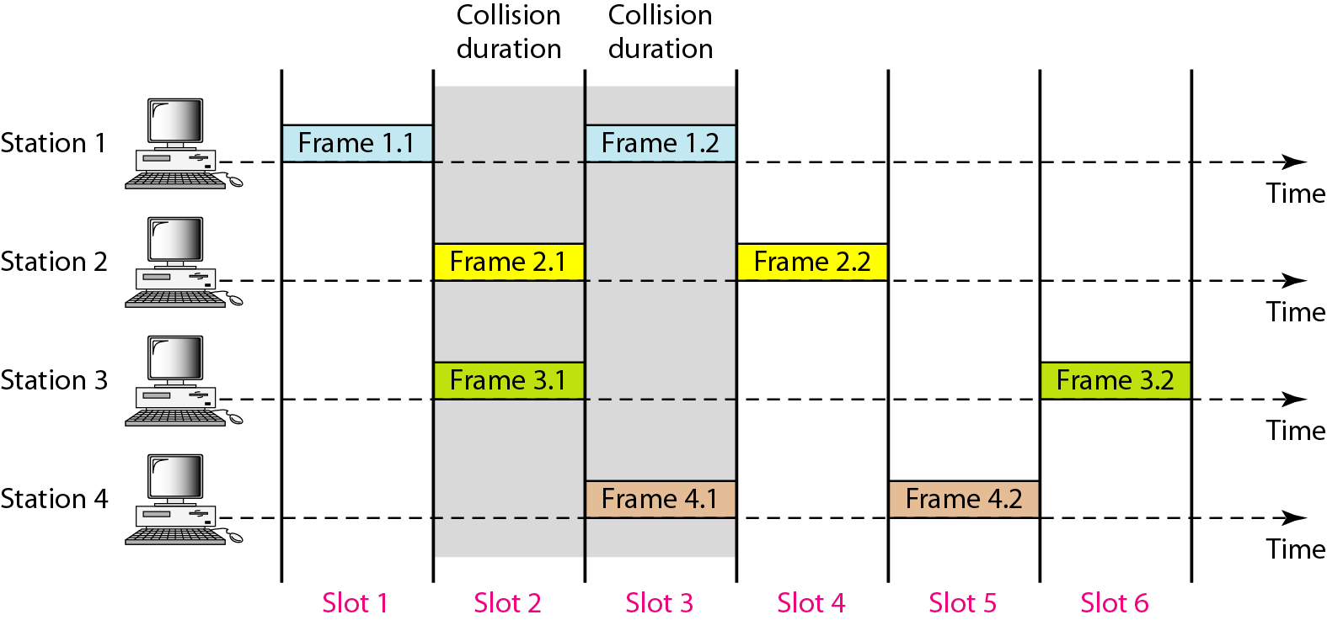
Figure 12.6 Frames in a slotted ALOHA network

Slide 23
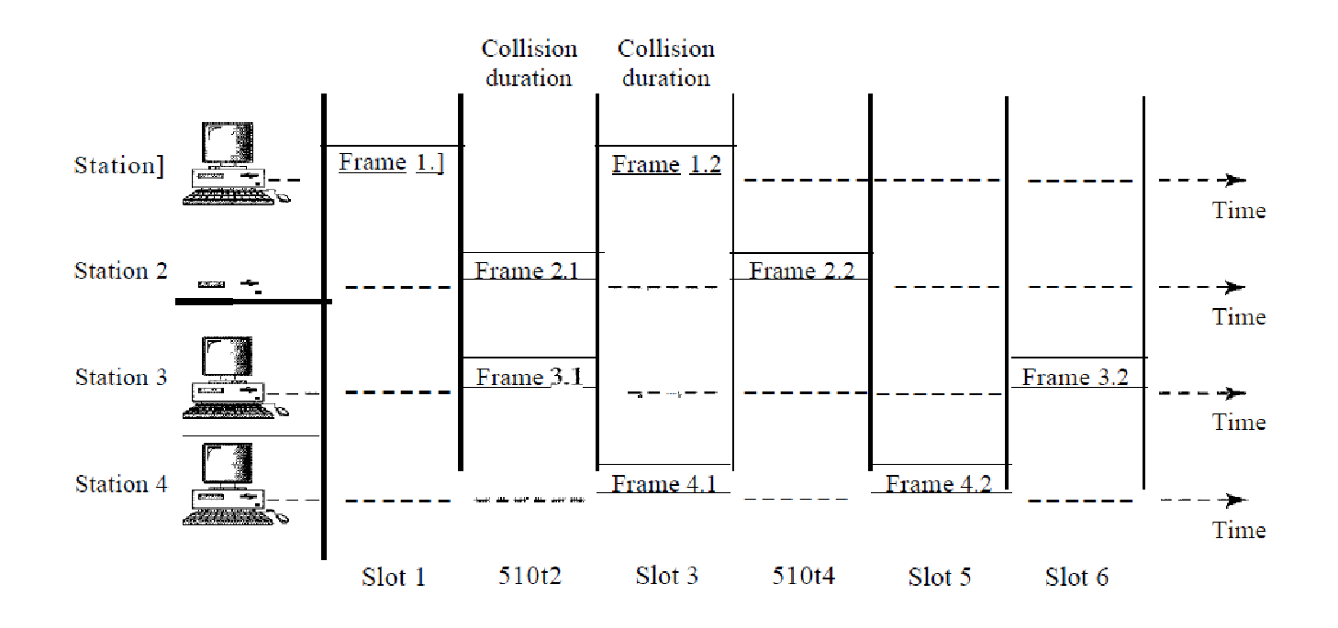

Slide 24
4.2.2. Carrier Sense Multiple Access Protocols (1)
With slotted ALOHA the best channel utilization that can be achieved is 1/e. This is hardly surprising, since with stations transmitting at will, without paying attention to what the other station are doing, there are bound to be many collisions.

Slide 25
Carrier Sense Multiple Access Protocols (2)
In local area networks, however, it is possible for station to detect what other station are doing, and adapt their behavior accordingly. This networks can achieve a much better utilization than 1/e.
In this section we will discuss some protocols for improving performance

Slide 26
Carrier Sense Multiple Access Protocols (3)
Protocols in which stations listen for a carrier (i.e., a transmission) and act accordingly are called carrier sense protocols.
A number of them have been proposed.

Slide 27
1-persistent CSMA (Carrier Sense Multiple Access)
nonpersistent CSMA
p-persistent CSMA
CSMA with Collision Detection (CSMA/CD)
CSMA with Collision Avoidance (CSMA/CA)

Slide 28
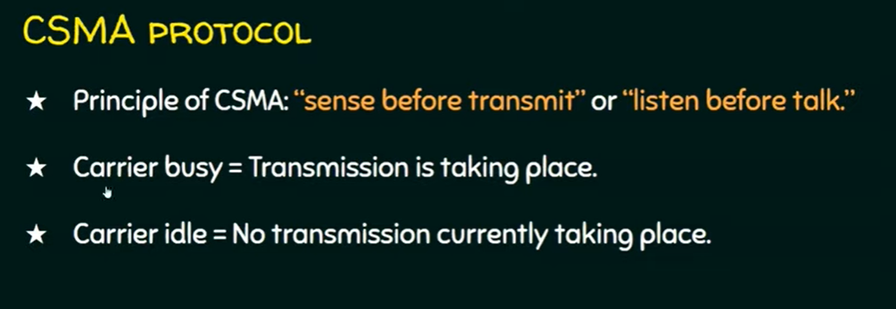

Slide 29
1-persistent CSMA (Carrier Sense Multiple Access)
When a station has data to send, it first listens to the channel to see if anyone else is transmitting at that moment.
If the channel is busy, the station waits until it becomes idle.
When the station detects an idle channel, it transmits a frame.
If a collision occurs, the station waits a random amount of time and starts all over again.
The protocol is called 1-persistent because the station transmits with a probability of 1 when it finds the channel idle.

Slide 30
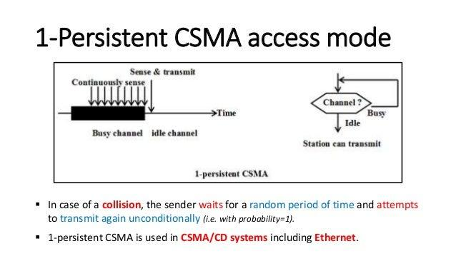

Slide 31
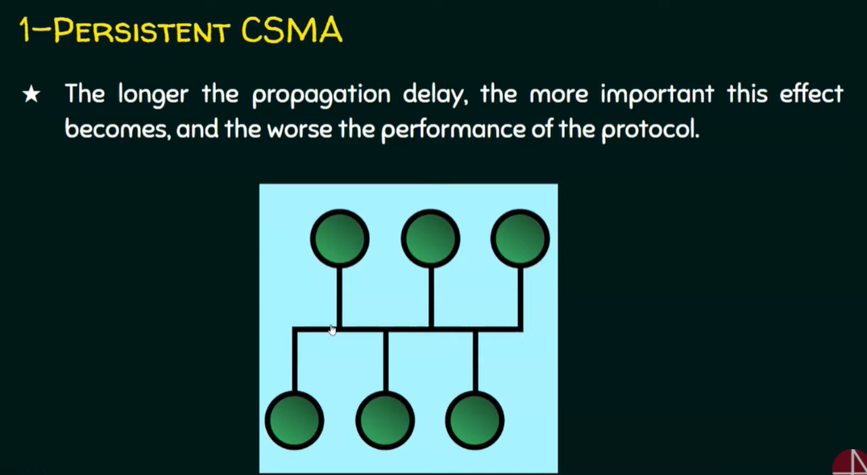

Slide 32
Nonpersistent-0 CSMA (Carrier Sense Multiple Access)
Before sending, a station senses the channel.
If no one else is sending, the station begins doing so itself.
However, if the channel is already in use, the station does not continually sense it for the purpose of seizing it immediately upon detecting the end of the previous transmission.
Instead, it waits a random period of time and then repeats the algorithm. Consequently, this algorithm leads to better channel utilization but longer delays than 1-persistent CSMA.

Slide 33
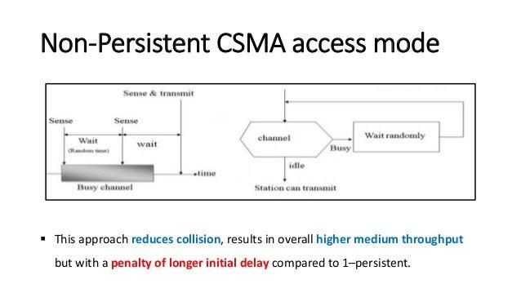

Slide 34
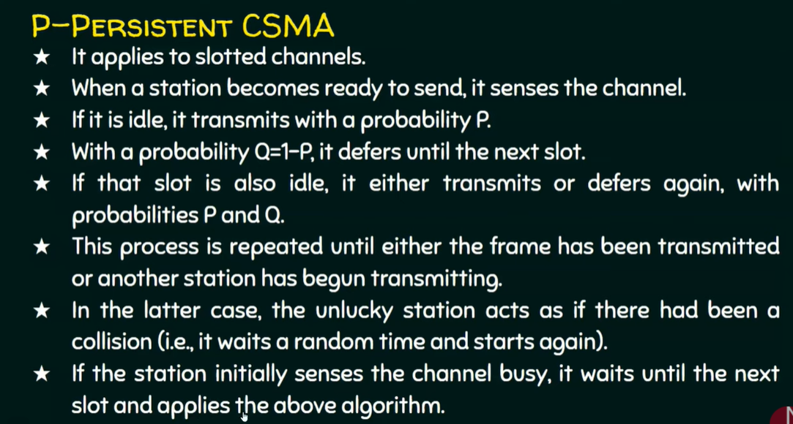

Slide 35
P-persistent CSMA (Carrier Sense Multiple Access)
It applies to slotted channel and works as follows.
When a station becomes ready to send, it sense the channel.
If it is idle, it transmits with a probability p.
With a probability q=1-p, it defers until the next slot.
If that slot is also idle, it either transmits or defers again, with probabilities p and q.
This process is repeated until either the frame has been transmitted or another station has begun transmitting.

Slide 36
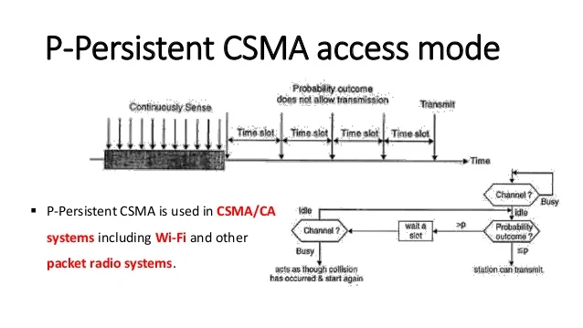

Slide 37
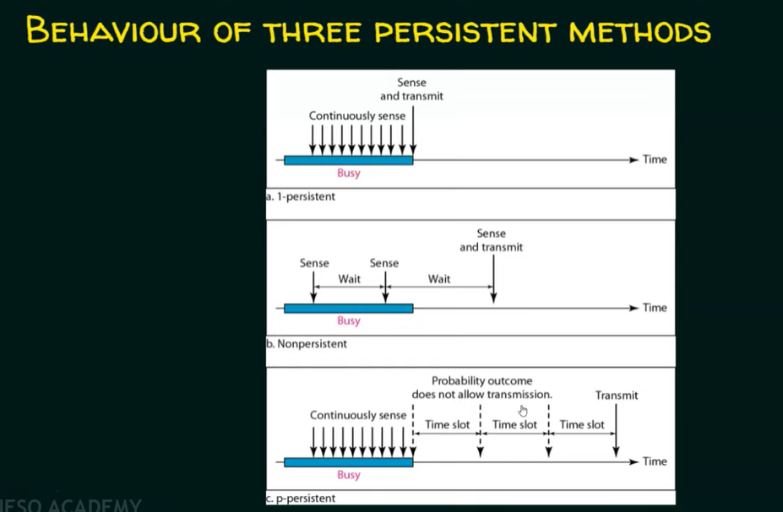

Slide 38
CSMA with Collision Detection(1)
Another improvement over ALOHA is for station to abort their transmissions as soon as they detect a collision.
In other words, if two stations sense the channel to be idle and begin transmitting simultaneously, they will both detect the collision almost immediately.
Rather than finish transmitting their frames, which are irretrievably garbled anyway, they should abruptly stop transmitting as soon as the collision is detected.
Quickly terminating damaged frames saves time and bandwidth.
This protocol is widely used on LANs in the MAC sublayer.

Slide 39
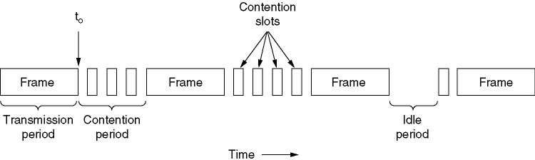
CSMA with Collision Detection (2)
CSMA/CD can be in one of three states: contention,
transmission, or idle.
A contention period or contention slot is the minimum time a host must transmit such that it can be sure that no other host packets has been transmitting

Slide 40
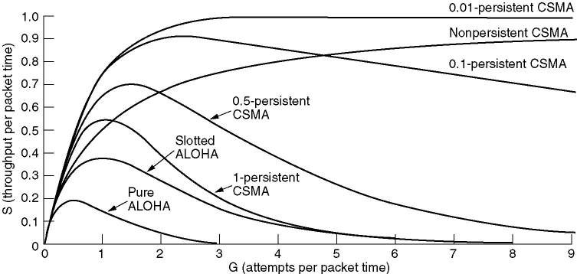
CSMA PROTOCOLS’ PERFORMANCE
Comparison of the channel utilization versus load for various
random access protocols.

Slide 41
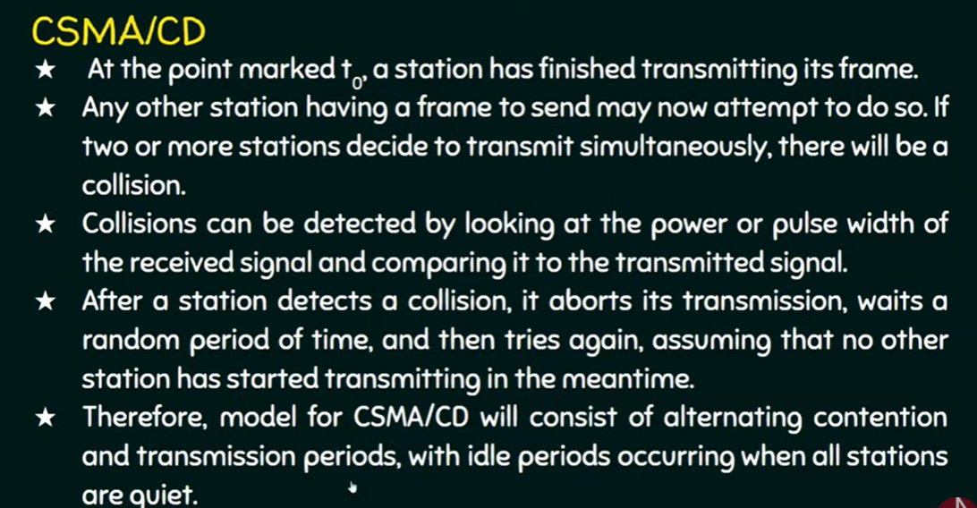

Slide 42
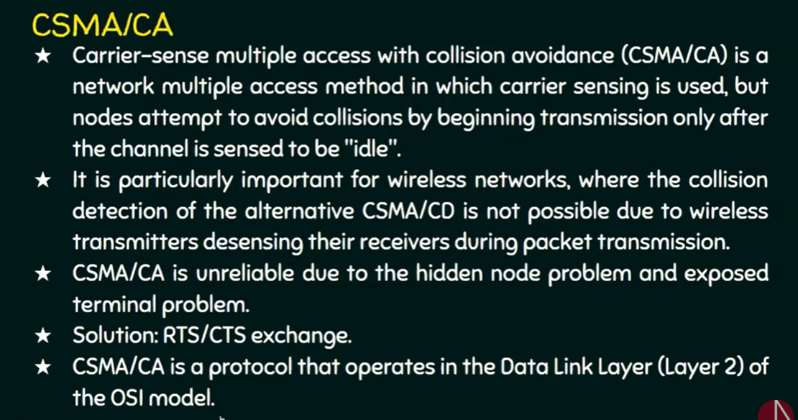
CSMA with Collision Avoidance (CSMA/CA)

Slide 43
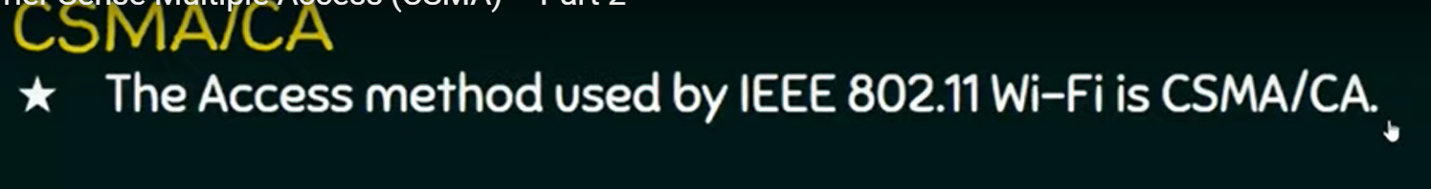

Slide 44
Collision-Free Protocols
Although collisions do not occur with CSMA/CD once a station has unambiguously captured the channel, they can still occur during the contention period.
These collisions adversely affect the system performance, especially when the cable is long and the frames are short. And CSMA/CD is not universally applicable.

Slide 45
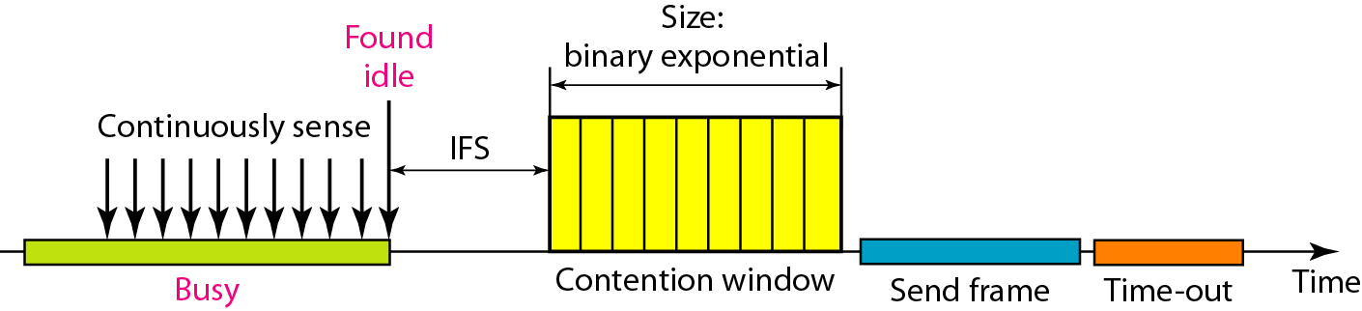
Figure 12.16 Timing in CSMA/CA

Slide 46

Note
In CSMA/CA, the IFS can also be used to define the priority of a station or a frame.

Slide 47
Note
In CSMA/CA, if the station finds the channel busy, it does not restart the timer of the contention window;
it stops the timer and restarts it when the channel becomes idle.

Slide 48
Collision avoidance mechanisms
Problem:
two nodes, hidden from each other, transmit complete frames to base station
wasted bandwidth for long duration !
Solution:
small reservation packets
nodes track reservation interval with internal “network allocation vector” (NAV)

Slide 49
Collision-Free Protocols (2)
In this section, we will examine two protocols that resolve the contention for channel without any collisions at all, not even during the contention period.
a bit-map protocol
binary countdown

Slide 50
Collision-Free Protocols
Assumptions for these two protocols:
there are exactly n stations, each with a unique address from 0 to n-1 “wired” into it.
propagation delay is negligible

Slide 51
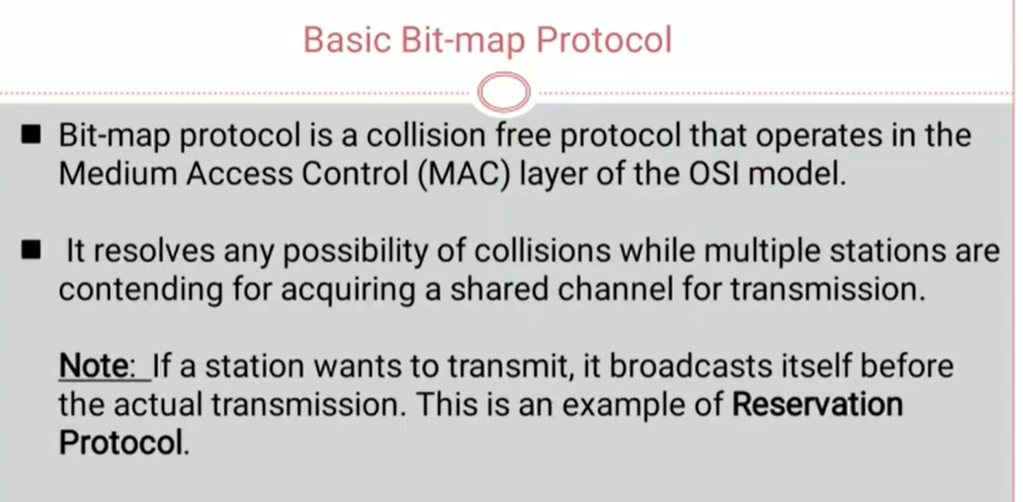

Slide 52
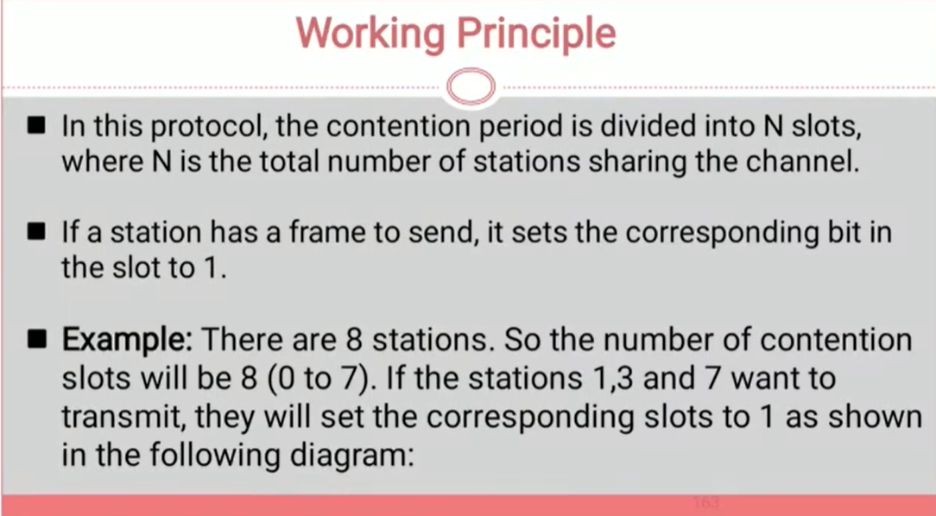

Slide 53
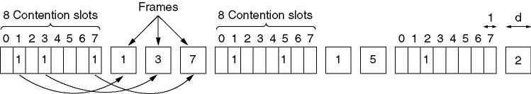
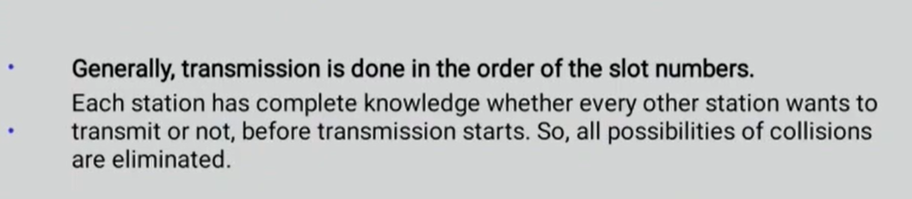
BASIC BIT-MAP PROTOCOL
The basic bit-map protocol.

Slide 54
Collision-Free Protocols
BINARY COUNTDOWN (1)
A problem with the basic bit-map protocol is that the overhead is 1 bit per station, so it does not scale well to networks with thousands of stations.

Slide 55
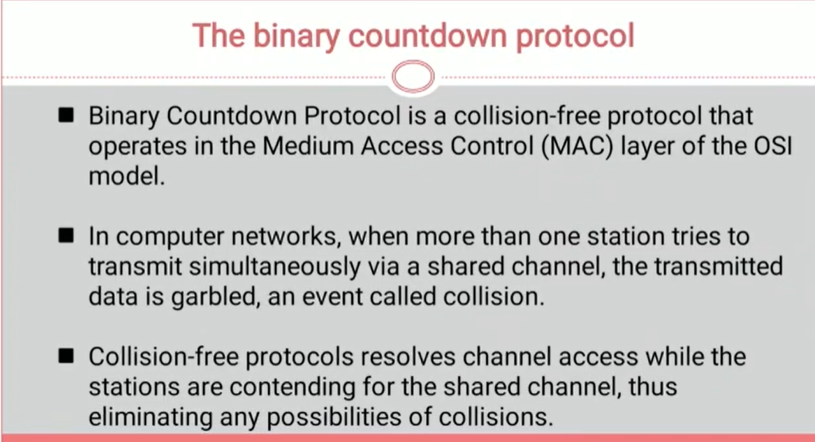

Slide 56
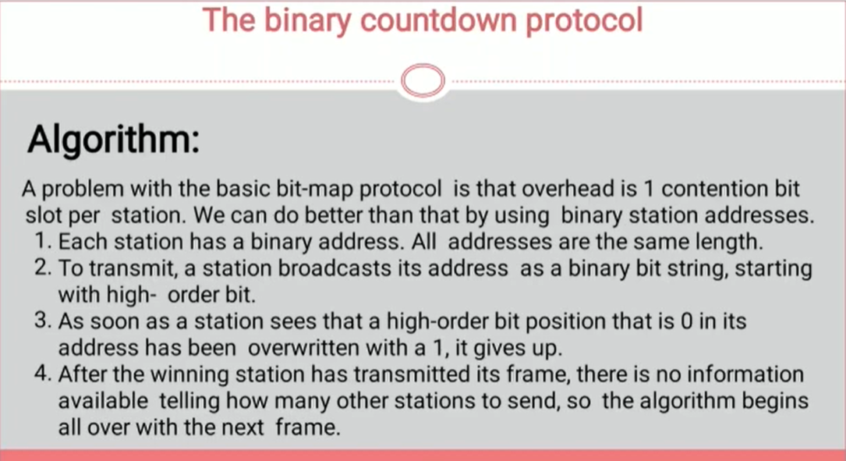

Slide 57
Collision-Free Protocols (7)
BINARY COUNTDOWN (2)
We can do better than that by using binary station addresses.
A station wanting to use the channel now broadcasts its address as a binary bit string, starting with the high-order bit.
All addresses are assumed to be the same length.
The bits in each address position from different stations are Boolean ORed together.

Slide 58
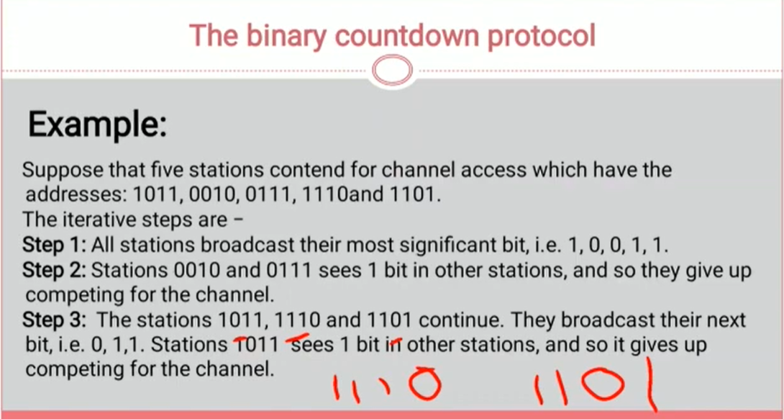

Slide 59
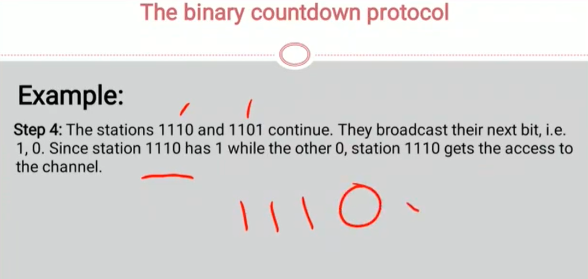

Slide 60
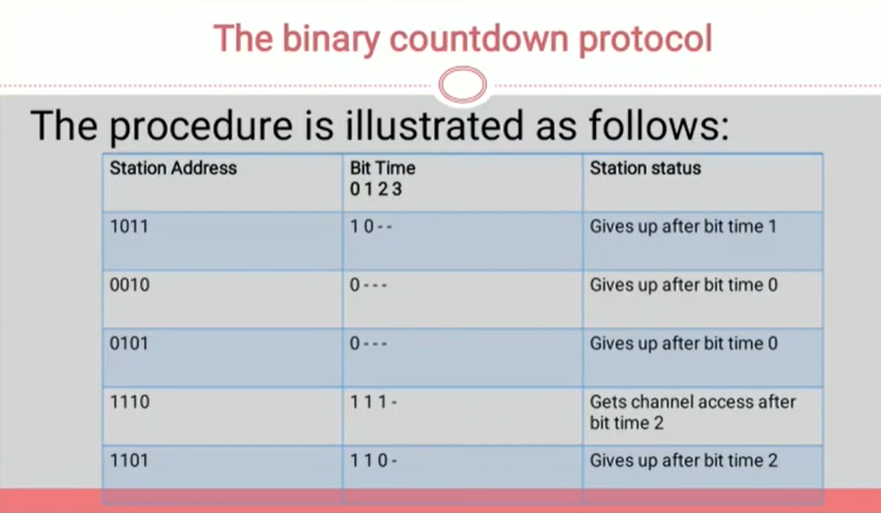

Slide 61
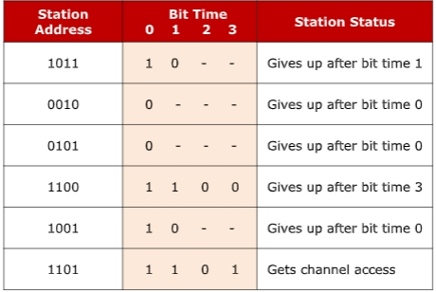

Slide 62
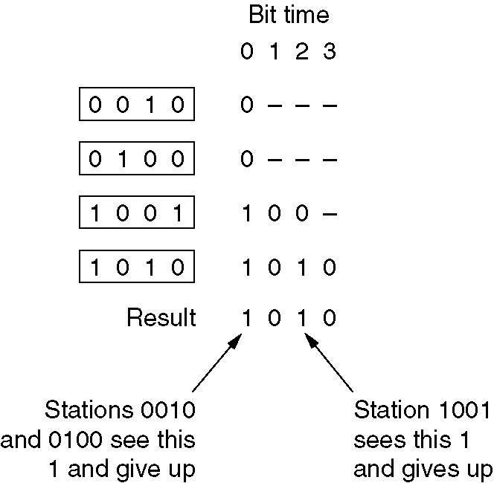
Collision-Free Protocols (8)
BINARY COUNTDOWN (3)
The binary countdown protocol. A dash indicates silence.

Slide 63
ETHERNET:
IEEE STANDARDS
The LAN market has several technologies such as Ethernet, Token Ring, Token Bus, FDDI, and ATM LAN.
In 1985, the Computer Society of the IEEE started a project, called Project 802, to set standards to enable intercommunication among equipment from a variety of manufacturers. Project 802 is a way of specifying functions of the physical layer and the data link layer of major LAN protocols.

Slide 64
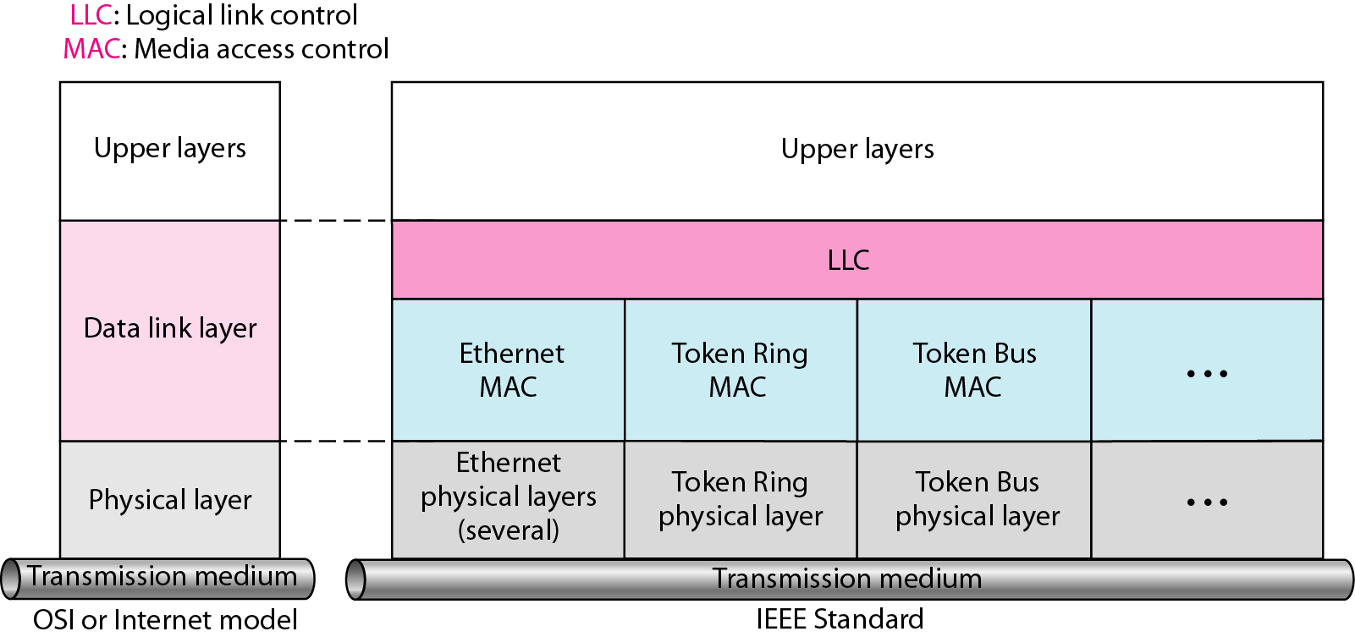
The IEEE has subdivided data link layer into two sublayers: logical link control (LLC) and media access control (MAC).
Figure IEEE standard for LANs

Slide 65
Logical Link Control:
In IEEE Project 802, flow control, error control and part of framing duties are collected into one sublayer called the logical link control.
The LLC provides one single data link control protocol for all IEEE LANs.
A single LLC protocol can provide interconnectivity between different LANs because it makes the MAC sublayer transparent.
Framing:
LLC defines a Protocol data unit (PDU) has the header field which is used for flow and error control.
The two other header fields define the upper-layer protocol at the source and destination that uses LLC – destination service access point and source service access point.

Slide 66
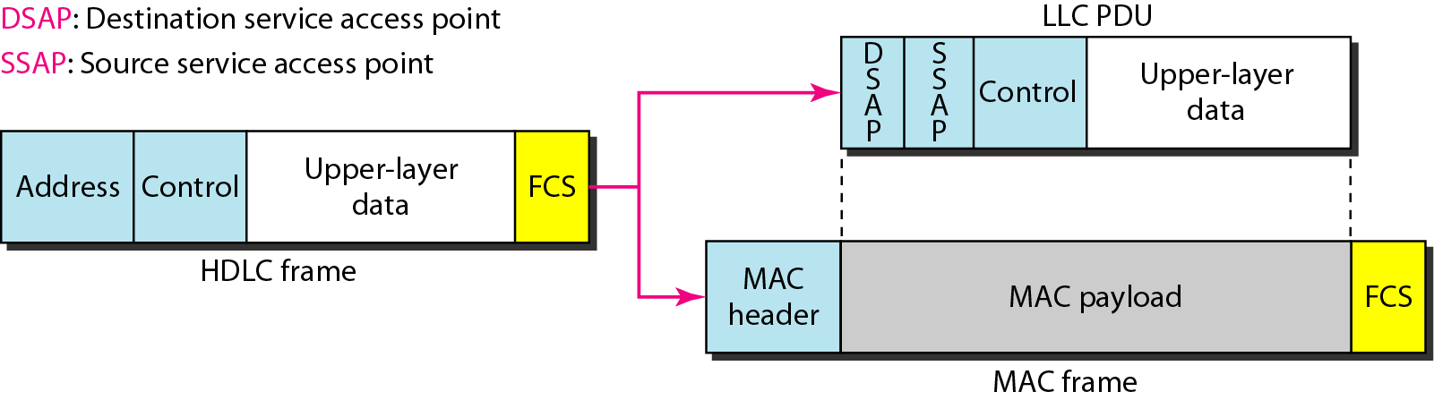
Figure HDLC frame compared with LLC and MAC frames
FCS (Frame Check Sequence)
Medium Access Control
It specifies the media access method for each LAN.
For example, it defines CSMA/CD as the media access method for Ethernet LANs and the token-passing method for Token Ring and Token Bus LANs.
It defines the access method and the framing format specific to corresponding LAN protocol.

Slide 67
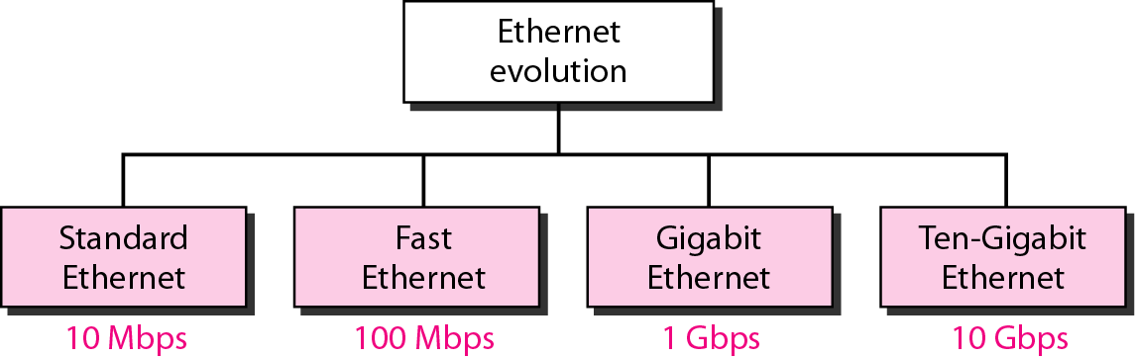
STANDARD ETHERNET:
The original Ethernet was created in 1976 at Xerox’s Palo Alto Research Center (PARC). Since then, it has gone through four generations. We briefly discuss the Standard (or traditional) Ethernet in this section.
Figure Ethernet evolution through four generations

Slide 68
MAC SUBLAYER:
In standard Ethernet, the MAC sublayer governs the operation of the access method.
It also frames data received from the upper layers and passes them to the physical layer.
Frame Format:
Ethernet does not provide any mechanism for acknowledging received frames.
This frame contains 7 fields: preamble, SFD, DA, SA, length or type of protocol data unit, upper-layer data and CRC.

Slide 69
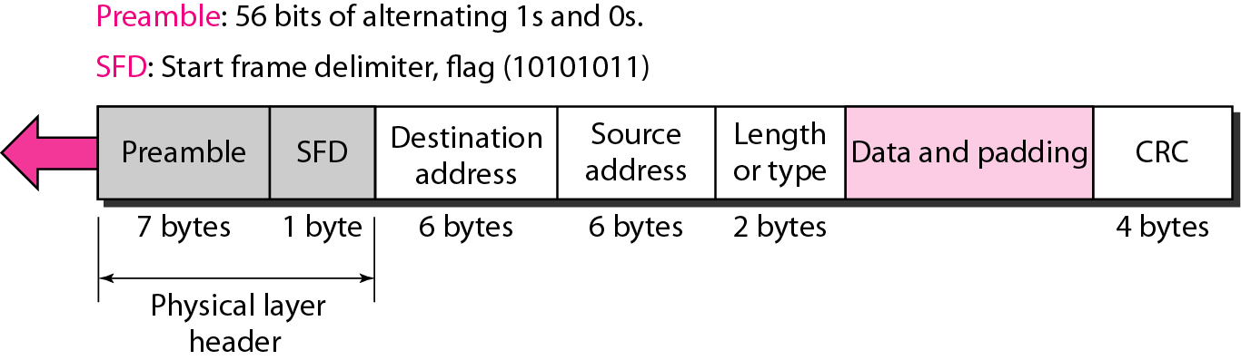
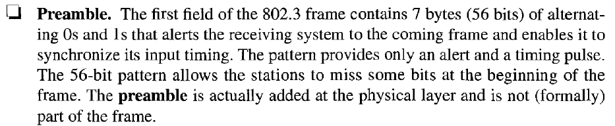
Figure 13.4 802.3 MAC frame

Slide 70
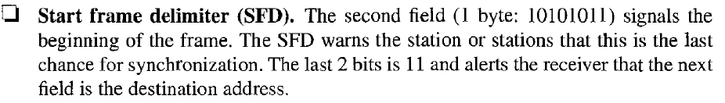
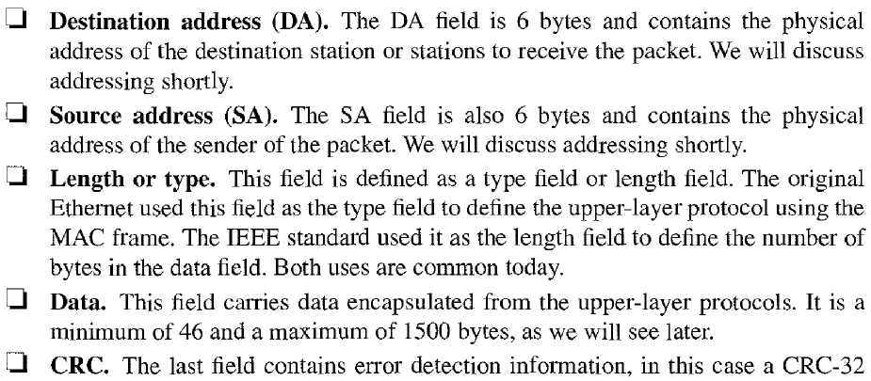

Slide 71
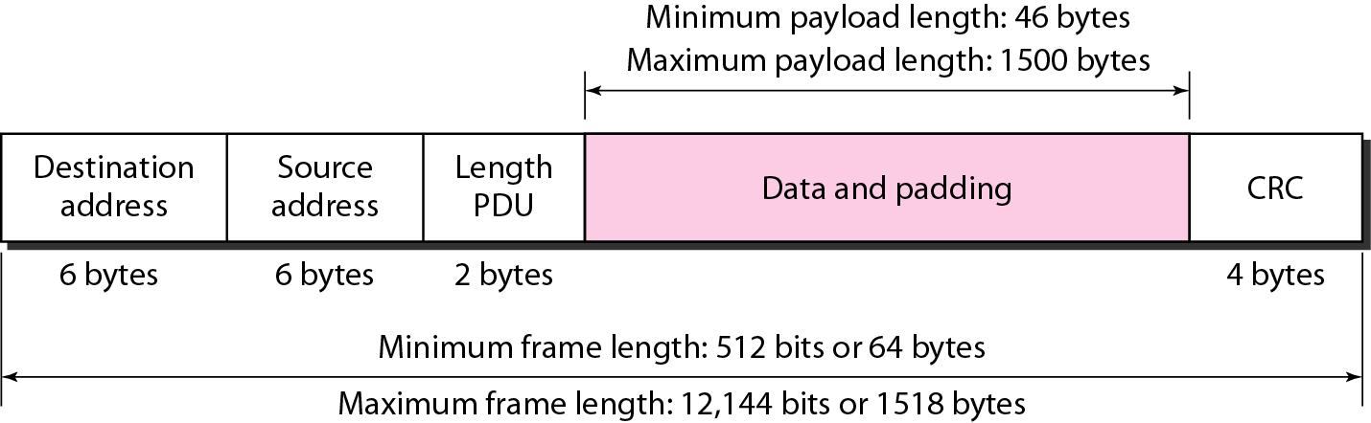
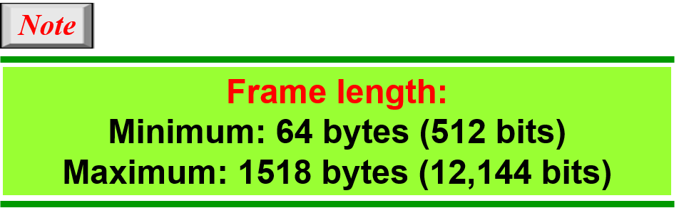
Figure Minimum and maximum lengths

Slide 72
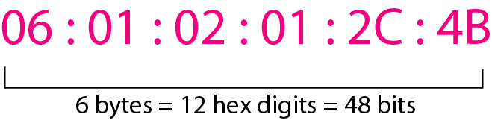
Addressing:
Each station on an Ethernet network has its own Network Interface Card (NIC).
The NIC fits inside the station and provides the station with a 6-byte physical address.
The Ethernet address is a 6-byte (48 bits), normally written in hexa-decimal notation, with a colon between bytes.
Figure Example of an Ethernet address in hexadecimal notation

Slide 73
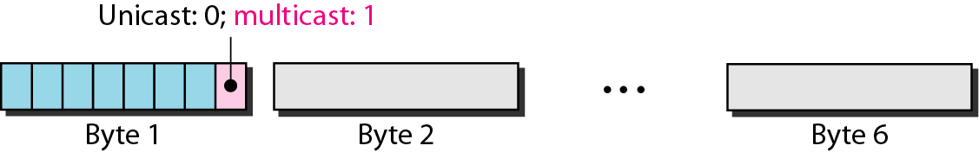
Unicast, multicast and broadcast addresses:
A source address is always a unicast address- the frame comes from only one station.
The destination address, however, can be unicast, multicast or broad cast address.
If the least significant bit for the first byte in a destination address is 0, the address is unicast; otherwise, it is multicast.
A unicast destination address defines only one recipient and the relationship between sender and receiver is one-to-one.
A multicast destination address defines a group of addresses and the relationship between sender and receiver is one-to-many.
The broadcast address is a special case of multicast address and the recipients are all the stations in the LAN.

Slide 74
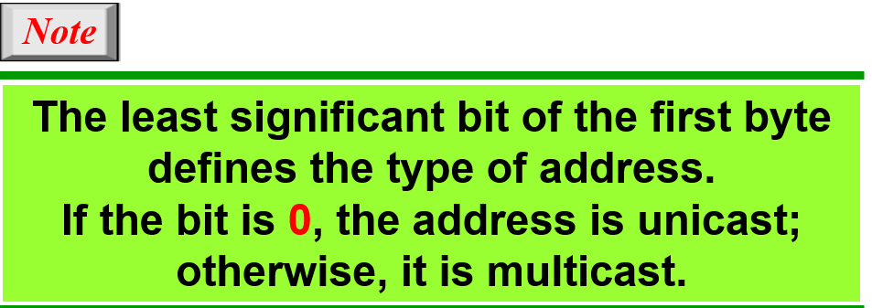
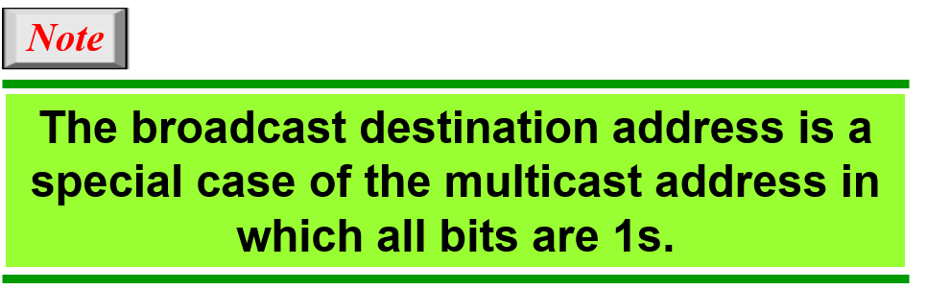

Slide 75
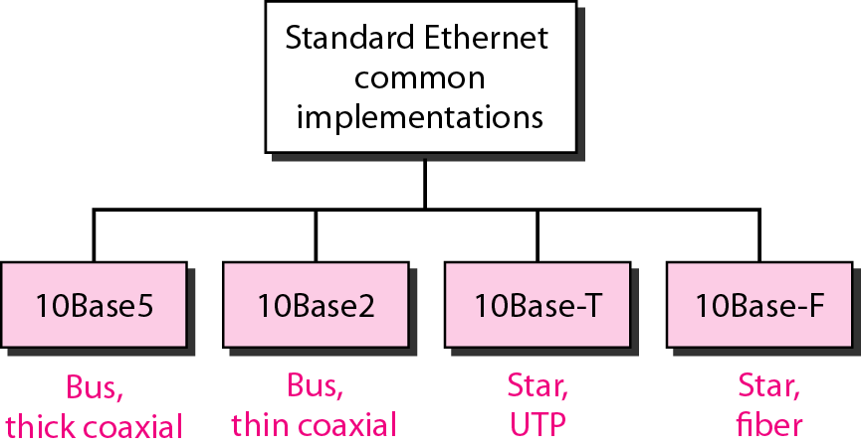
Figure Categories of Standard Ethernet

Slide 76
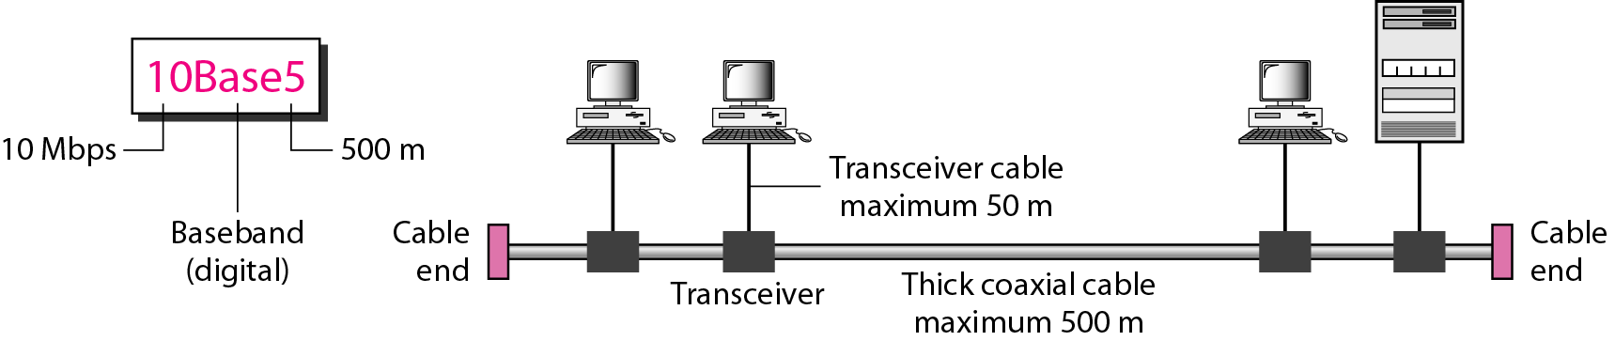
lOBase5: Thick Ethernet
The first implementation is called 10Base5, thick Ethernet, or Thicknet.
The nickname derives from the size of the cable, which is roughly the size of a garden hose and too stiff to bend with your hands.
lOBase5 was the first Ethernet specification to use a bus topology with an external transceiver (transmitter/receiver) connected via a tap to a thick coaxial cable.
Figure 13.10 10Base5 implementation

Slide 77
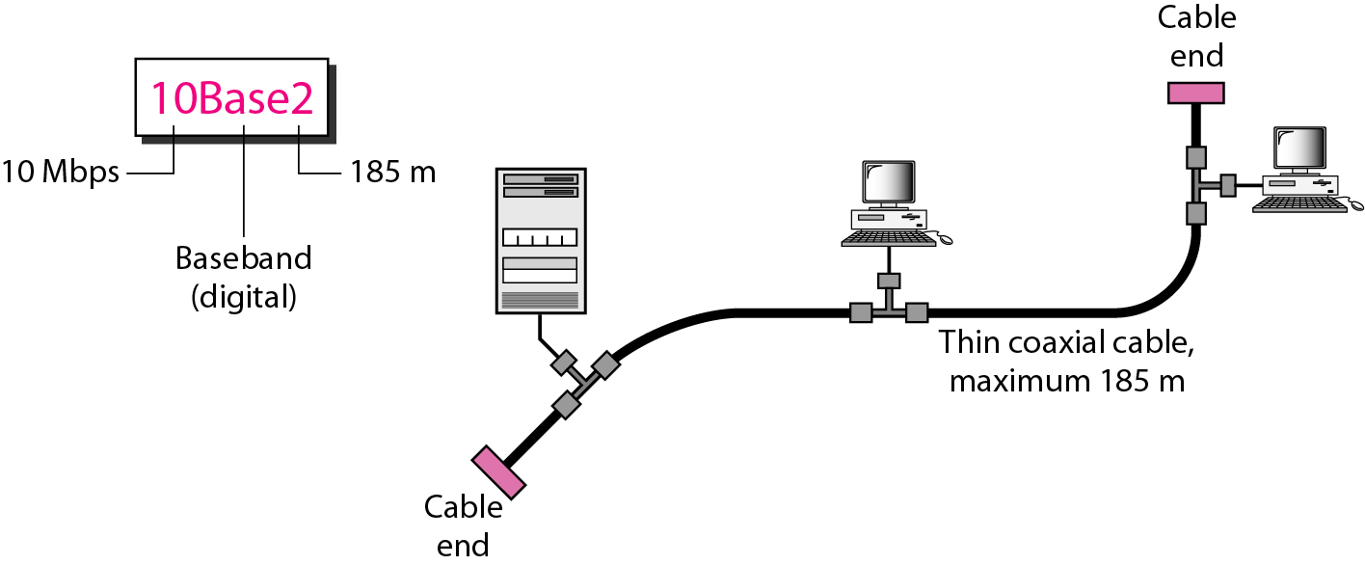
10Base2: Thin Ethernet
The second implementation is called lOBase2, thin Ethernet, or Cheaper net. IOBase2 also uses a bus topology, but the cable is much thinner and more flexible.
The cable can be bent to pass very close to the stations. In this case, the transceiver is normally part of the network interface card (NIC), which is installed inside the station.
Figure 13.11 10Base2 implementation

Slide 78
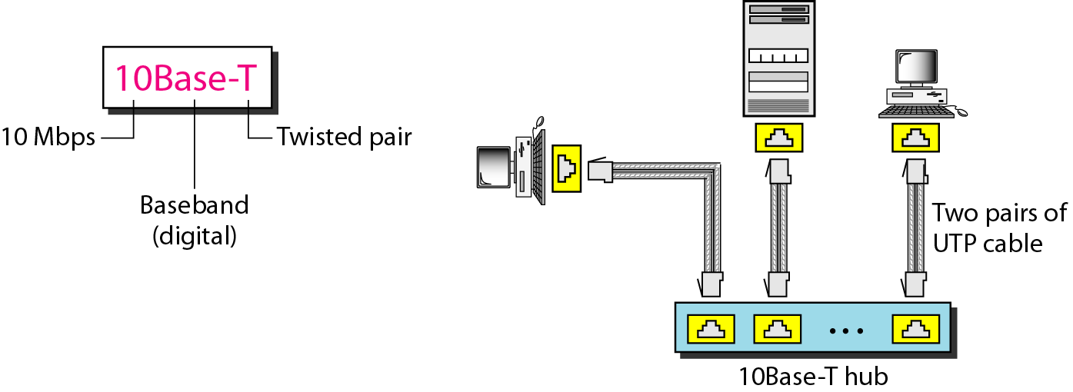
lOBase-T: Twisted-Pair Ethernet
The third implementation is called lOBase-T or twisted-pair Ethernet. 1OBase-T uses a physical star topology. The stations are connected to a hub via two pairs of twisted cable, as shown in Figure 13.12
Figure 13.12 10Base-T implementation

Slide 79
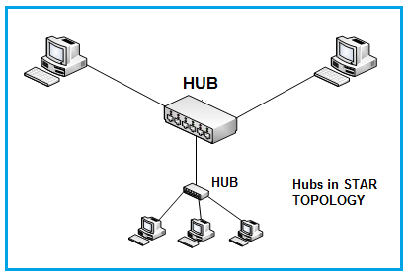
A network hub is a node that broadcasts data to every computer or Ethernet-based device connected to it

Slide 80

lOBase-F: Fiber Ethernet
Although there are several types of optical fiber lO-Mbps Ethernet, the most common is called 10Base-F. lOBase-F uses a star topology to connect stations to a hub.
The stations are connected to the hub using two fiber-optic cables, as shown in Figure 13.13.
Figure 13.13 10Base-F implementation

Slide 81
FAST ETHERNET:
Fast Ethernet was designed to compete with LAN protocols such as FDDI or Fiber Channel (or Fibre Channel, as it is sometimes spelled). IEEE created Fast Ethernet under the name 802.3u. Fast Ethernet is backward-compatible with Standard Ethernet, but it can transmit data 10 times faster at a rate of 100 Mbps.
The goals of Fast Ethernet can be summarized as follows:
1. Upgrade the data rate to 100 Mbps.
2. Make it compatible with Standard Ethernet.
3. Keep the same 48-bit address.
4. Keep the same frame format.
5. Keep the same minimum and maximum frame lengths

Slide 82

FDDI (Fiber Distributed Data Interface) is a network standard that uses fiber optic connections in a local area network (LAN) that can extend in range up to 200 kilometers (124 miles).

Slide 83

Figure Fast Ethernet implementations

Slide 84
GIGABIT ETHERNET:
The need for an even higher data rate resulted in the design of the Gigabit Ethernet protocol (1000 Mbps). The IEEE committee calls the Standard 802.3z.
The goals of the Gigabit Ethernet design can be summarized as follows:
1. Upgrade the data rate to 1 Gbps.
2. Make it compatible with Standard or Fast Ethernet.
3. Use the same 48-bit address.
4. Use the same frame format.
5. Keep the same minimum and maximum frame lengths.
6. To support auto negotiation as defined in Fast Ethernet.

Slide 85

Figure Gigabit Ethernet implementations

Slide 86
DATA LINK LAYER SWITCHING:
Network switching is the process of forwarding data frames or packets from one port to another leading to data transmission from source to destination.
Data link layer is the second layer of the Open System Interconnections (OSI) model whose function is to divide the stream of bits from physical layer into data frames and transmit the frames according to switching requirements.
Switching in data link layer is done by network devices called bridges.
Bridges:
A data link layer bridge connects multiple LANs (local area networks) together to form a larger LAN.
This process of aggregating networks is called network bridging.
A bridge connects the different components so that they appear as parts of a single network.

Slide 87

A bridge is a network device that connects multiple LANs (local area networks) together to form a larger LAN. The process of aggregating networks is called network bridging.
A bridge connects the different components so that they appear as parts of a single network. Bridges operate at the data link layer of the OSI model and hence also referred as Layer 2 switches.
The following diagram shows a bridge connecting two LANs −

Slide 88
Switching by Bridges:
When a data frame arrives at a particular port of a bridge, the bridge examines the frame’s data link address, or more specifically, the MAC address.
If the destination addresses as well as the required switching is valid, the bridge sends the frame to the destined port. Otherwise, the frame is discarded.
The bridge is not responsible for end-to-end data transfer. It is concerned with transmitting the data frame from one hop to the next. Hence, they do not examine the payload field of the frame.
Due to this, they can help in switching any kind of packets from the network layer above.
Bridges also connect virtual LANs (VLANs) to make a larger VLAN.
If any segment of the bridged network is wireless, a wireless bridge is used to perform the switching.
There are three main ways for bridging −
simple bridging
multi-port bridging
learning or transparent bridging

Slide 89
USES OF BRIDGE:
Bridges connects two or more different LANs that has a similar protocol and provides communication between the devices (nodes) in them.
By joining multiple LANs, bridges help in multiplying the network capacity of a single LAN.
Since they operate at data link layer, they transmit data as data frames. On receiving a data frame, the bridge consults a database to decide whether to pass, transmit or discard the frame.
If the frame has a destination MAC (media access control) address in the same network, the bridge passes the frame to that node and then discards it.
If the frame has a destination MAC address in a connected network, it will forward the frame toward it.

Slide 90
By deciding whether to forward or discard a frame, it prevents a single faulty node from bringing down the entire network.
In cases where the destination MAC address is not available, bridges can broadcast data frames to each node. To discover new segments, they maintain the MAC address table.
In order to provide full functional support, bridges ideally need to be transparent. No major hardware, software or architectural changes should be required for their installation.
Bridges can switch any kind of packets, be it IP packets or AppleTalk packets, from the network layer above. This is because bridges do not examine the payload field of the data frame that arrives, but simply looks at the MAC address for switching.
Bridges also connect virtual LANs (VLANs) to make a larger VLAN.
A wireless bridge is used to connect wireless networks or networks having a wireless segment.

Slide 91
AppleTalk is a discontinued proprietary suite of networking protocols developed by Apple Inc. for their Macintosh computers. AppleTalk includes a number of features that allow local area networks to be connected with no prior setup or the need for a centralized router or server of any sort.

Slide 92
Learning Bridge and Spanning Tree
Lecture 3

Slide 93
Bridges
Link Layer devices: operate on Ethernet frames, examining frame header and selectively forwarding frame based on its destination
Bridge isolates collision domains since it buffers frames
When frame is to be forwarded on segment, bridge uses CSMA/CD to access segment and transmit

Slide 94
Bridges (more)
Bridge advantages:
Isolates collision domains resulting in higher total max throughput, and does not limit the number of nodes nor geographical coverage
Can connect different type Ethernet since it is a store and forward device
Transparent: no need for any change to hosts LAN adapters

Slide 95
Spanning Tree Protocol (STP) is a Layer 2 network protocol used to prevent looping within a network topology. STP was created to avoid the problems that arise when computers exchange data on a local area network (LAN) that contains redundant paths.

Slide 96

Backbone Bridge

Slide 97

Interconnection Without Backbone
Not recommended for two reasons:
- single point of failure at Computer Science hub
- all traffic between EE and SE must path over CS segment

Slide 98
Bridges: frame filtering, forwarding
bridges filter packets
same-LAN -segment frames not forwarded onto other LAN segments
forwarding:
how to know on which LAN segment to forward frame?

Slide 99
Introducing Spanning Tree
Allow a path between every LAN without causing loops (loop-free environment)
Bridges communicate with special configuration messages (BPDUs)
Standardized by IEEE 802.1D
Note: redundant paths are good, active redundant paths are bad (they cause loops)

Slide 100
Spanning Tree Requirements
Each bridge is assigned a unique identifier
A broadcast address for bridges on a LAN
A unique port identifier for all ports on all bridges
MAC address
Bridge id + port number

Slide 101

Spanning Tree Concepts: Root Bridge
The bridge with the lowest bridge ID value is elected the root bridge
One root bridge chosen among all bridges
Every other bridge calculates a path
to the root bridge

Slide 102
Spanning Tree Concepts: Path Cost
A cost associated with each port on each bridge
default is 1
The cost associated with transmission onto the LAN connected to the port
Can be manually or automatically assigned
Can be used to alter the path to the root bridge

Slide 103

Spanning Tree Concepts: Root Port
The port on each bridge that is on the path towards the root bridge
The root port is part of the lowest cost path towards the root bridge
If port costs are equal on a bridge, the port with the lowest ID becomes root port

Slide 104

Spanning Tree Concepts: Root Path Cost
The minimum cost path to the root bridge
The cost starts at the root bridge
Each bridge computes root path cost independently based on their view of the network

Slide 105

Spanning Tree Concepts: Designated Bridge
Only one bridge on a LAN at one time is chosen the designated bridge
This bridge provides the minimum cost path to the root bridge for the LAN
Only the designated bridge passes frames towards the root bridge

Slide 106


Slide 107


Slide 108


Slide 109


Slide 110


Slide 111


Slide 112
Example Spanning Tree
B8
B3
B5
Protocol operation:
Picks a root
For each LAN, picks a designated bridge that is closest to the root.
All bridges on a LAN send packets towards the root via the designated bridge.
B7
B2
B1
B6
B4

Slide 113
Example Spanning Tree
B8
B3
Spanning Tree:
B5
B1
root
port
B7
B2
B2
B4
B5
B7
B1
Root
B8
Designated
Bridge
B6
B4

Slide 114
Spanning Tree Algorithm: An Overview
1. Determine the root bridge among all bridges
2. Each bridge determines its root port
The port in the direction of the root bridge
3. Determine the designated bridge on each LAN
The bridge which accepts frames to forward towards the root bridge
The frames are sent on the root port of the designated bridge

Slide 115
Spanning Tree Algorithm: Select Designated Bridges
Initially, each bridge considers itself to be the designated bridge
Bridges send BDPU frames to its attached LANs
The bridge and port ID of the sending bridge
The bridge and port ID of the bridge the sending bridge considers root
The root path cost for the sending bridge
3. Best one wins
(lowest ID/cost/priority)

Slide 116
Forwarding/Blocking State
Root and designated bridges will forward frames to and from their attached LANs
All other ports are in the blocking state

Slide 117


Configuration Messages: BPDU

Slide 118
REPEATERS, HUBS, BRIDGES, SWITCHES

Slide 119

Introduction
All these devices operate in different layers as illustrated in below figure. The layer matters because different devices use different pieces of information to decide how to switch.

Slide 120

Repeaters
The repeater operates in the physical layer.
These are analog devices that work with signals on the cables to which they are connected.
A signal appearing on one cable is regenerated and put out on another cable. Hence it extends the physical length of LAN.
Repeaters do not understand frames, packets or headers. They understand the symbols that encode bit as volts.

Slide 121
Hub
A hub has a number of input lines that it joins electrically. Active hub and passive hub are two types of hubs.
Frames arriving on any of the lines are sent out on all the others. It is broadcast device. If two frames arrive at the same time, they will collide, just as on a coaxial cable.
Like repeaters, hubs are physical layer devices that do not examine the link layer addresses or use them in any way. It is not an intelligent device.

Slide 122
Bridge
A bridge connects two or more LANs. It operates at data link layer.
Like a hub, a modern bridge has multiple ports, usually enough for 4 to 48 input lines of a certain type. Unlike in a hub, each port is isolated to be its own collision domain.
When a frame arrives, the bridge extracts the destination address (for Ethernet, it is 48 bit) from the frame header and looks it up in a table to see where to send the frame.
The bridge only outputs the frame on the port where it is needed and can forward multiple frames at the same time.

Slide 123
Switch
Switches are modern bridges by another name. It acts as multiport bridge to connect devices or segments in a LAN. It operates at data link layer.
It is point to point device.
It is an intelligent device. It uses switching table to find the correct destination.
Switches are of two types:
i. Store-and-forward switch: It stores the frame in the input buffer until the whole packet has arrived.
ii. Cut-through switch: It forwards the packet to the output buffer as soon as the destination address is received.

Slide 124
Routers and Gateways

Slide 125
What is a router?
A router is a switching device for networks, which is able to route network packets, based on their addresses, to other networks or devices.
Among other things, they are used for Internet access, for coupling networks or for connecting branch offices to a central office via VPN (Virtual Private Network)
In the OSI layer model, the switching of data packets through the router is based on the address on the network layer (layer 3).

Slide 126

Router

Slide 127
How a router functions?
A router has multiple interfaces and receives data packets through them. It evaluates the network addresses of the incoming packets and decides which interface to forward the packet to.
It uses its local routing table for decision-making. This can be statically configured or calculated via dynamic routing protocols such as OSPF or BGP.

Slide 128
Various types of routers
Backbone routers are high-performance routers of the carrier class, which route and forward packets with rapid speeds of several gigabits per second. They are housed in data centres.
For interfacing with networks of other providers, Internet service providers may use border routers or edge routers, which mainly use the routing protocol BGP.
For connecting to the Internet, access routers are used, which allow devices in a local area network to access Internet via DSL, cable, wireless or ISDN.

Slide 129
Routers and telephony
Many Internet routers have additional functions for telephony. They often have full telephone systems integrated within the devices.
While a normal Internet connection provides sufficient access for VoIP telephony, routers with telephone systems for standard telephony need interfaces for access to the analogue or digital (ISDN) telephone network.

Slide 130
Gateways
A gateway is a network node used in telecommunications that connects 2 networks with different transmission protocols together.
Gateways serve as an entry and exit point for a network as all data must pass through or communicate with the gateway prior to being routed.
In most IP-based networks, the only traffic that does not go through at least one gateway is traffic flowing among nodes on the same local area network (LAN) segment. The term default gateway or network gateway may also be used to describe the same concept.

Slide 131
Gateways
The primary advantage of using a gateway in personal or enterprise scenarios is simplifying internet connectivity into one device. In the enterprise, a gateway node can also act as a proxy server and a firewall. Gateways can be purchased through popular technology retailers, such as Best Buy, or rented through an internet service provider.

Slide 132

Gateways

Slide 133
How gateways work?
All networks have a boundary that limits communication to devices that are directly connected to it. Due to this, if a network wants to communicate with devices, nodes or networks outside of that boundary, they require the functionality of a gateway.
A gateway is often characterized as being the combination of a router and a modem.
The gateway is implemented at the edge of a network and manages all data that is directed internally or externally from that network. When one network wants to communicate with another, the data packet is passed to the gateway and then routed to the destination through the most efficient path.

Slide 134
How gateways work?
In addition to routing data, a gateway will also store information about the host network’s internal paths and the paths of any additional networks that are encountered.
Gateways are basically protocol converters, facilitating compatibility between two protocols and operating on any layer of the open systems interconnection (OSI) model.

Slide 135
Types of gateways
Web application firewalls- This type filters traffic to and from a web server and looks at application-layer data.
Cloud storage gateways- This type translates storage requests with various cloud storage service API calls. It allows organizations to integrate storage from a private cloud into applications without migrating into a public cloud.
API, SOA or XML gateways – This type manages traffic flowing into and out of a service, microservices-oriented architecture or XML-based web service.
IoT gateways-This type aggregates sensor data from devices in an IoT environment, translates between sensor protocols and processes sensor data before sending it onward.
Media gateways- This type converts data from the format required for one type of network to the format required for another.
Email security gateways- This type prevents the transmission of emails that break company policy or will transfer information with malicious intent.
VoIP trunk gateways- This type facilitates the use of plain old telephone service equipment, such as landline phones and fax machines, with a voice over IP (VoIP) network.

Slide 136
Difference between a gateway and a router
Gateways and routers are similar in that they both can be used to regulate traffic between two or more separate networks. However, a router is used to join two similar types of networks and a gateway is used to join two dissimilar networks. Dissimilar could be used to describe networks that use different primary protocols.
Due to this logic, a router may be considered a gateway, but a gateway is not always considered a router. Routers are the most common gateway, used to connect a home or enterprise network to the internet.

